Slide 1
The Fundamental of Mobile Robot
Machine Perception and Interaction Group (MPIG)
http://www.mpig.com.cn
szl@mpig.com.cn

Slide 2
Send an email with specified subject ‘Robot stuff’ to
assignments.shmtu@gmail.com
An automatic reply will come.
All you need would be included!

Slide 3

assignments.shmtu@gmail.com

Slide 4


All the codes accompanying this course are open-sourced at Github.
The project homepage:
https://github.com/sunzuolei/robotcourse
The git repository:
https://github.com/sunzuolei/robotcourse.git
Learn more about git:
http://en.wikipedia.org/wiki/Git_(software)
The best GUI-based git client on Windows:
https://code.google.com/p/tortoisegit/

Slide 5
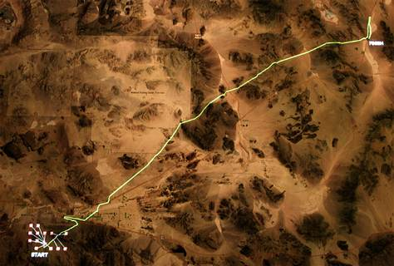
PID Control

Slide 6
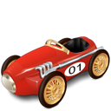
Steerable front axle and two non-steerable rear wheels.
Want the car to drive along the black line
Fixed forward velocity, but you have the ability to set the steering angle of the car
Cross-track error (CTE)

Slide 7

How would we control the steering so the robot follows the reference trajectory?
Cross-track error (CTE)

Slide 8
P (Proportional)
Controller

Slide 9
P71
for i = 1 : n
%% ================= P controller ===============
err = pos(2) - target;
steer = -tauP * err;
pos = moveRob(pos, constVel, steer, dt, wheelbase);
%% ==============================================
robBody = compound(pos,rob);
path(:, i) = pos;
steers(i, 1) = steer;
end
function newPos = moveRob(oldPos, vel, steer, dt, wheelbase)
% The function piTopi is required.
newPos(1) = oldPos(1) + vel * dt * cos(steer + oldPos(3));
newPos(2) = oldPos(2) + vel * dt * sin(steer + oldPos(3));
newPos(3) = oldPos(3) + vel * dt * sin(steer) / wheelbase;
newPos(3) = piTopi(newPos(3));
newPos = newPos';

Slide 10
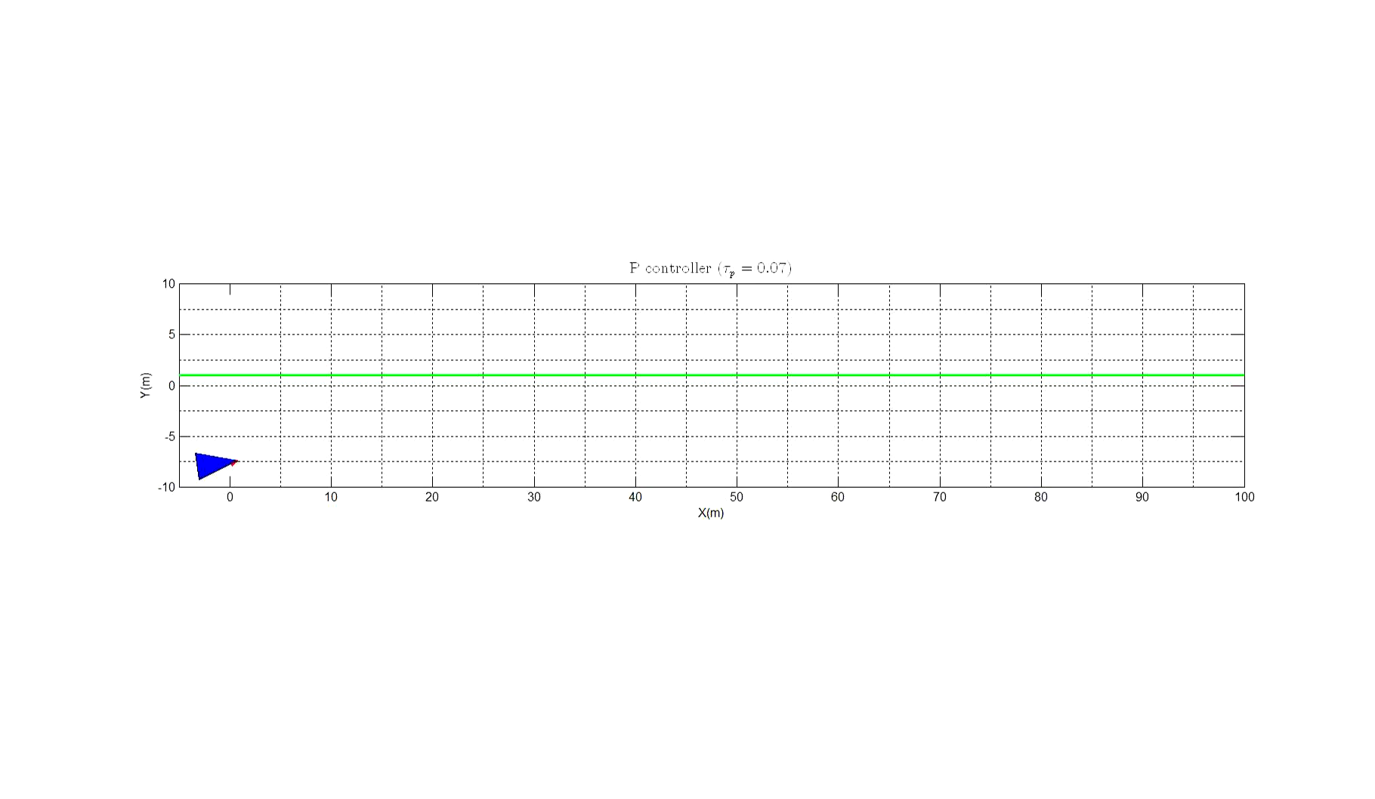
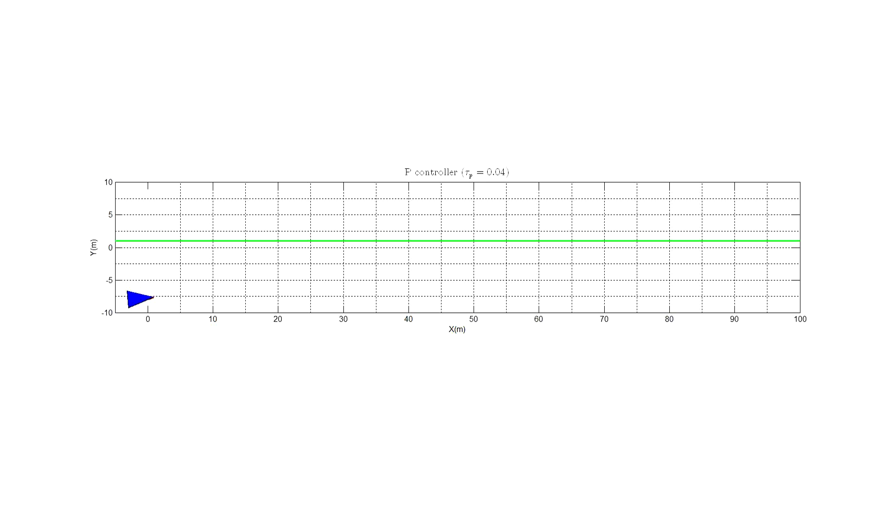
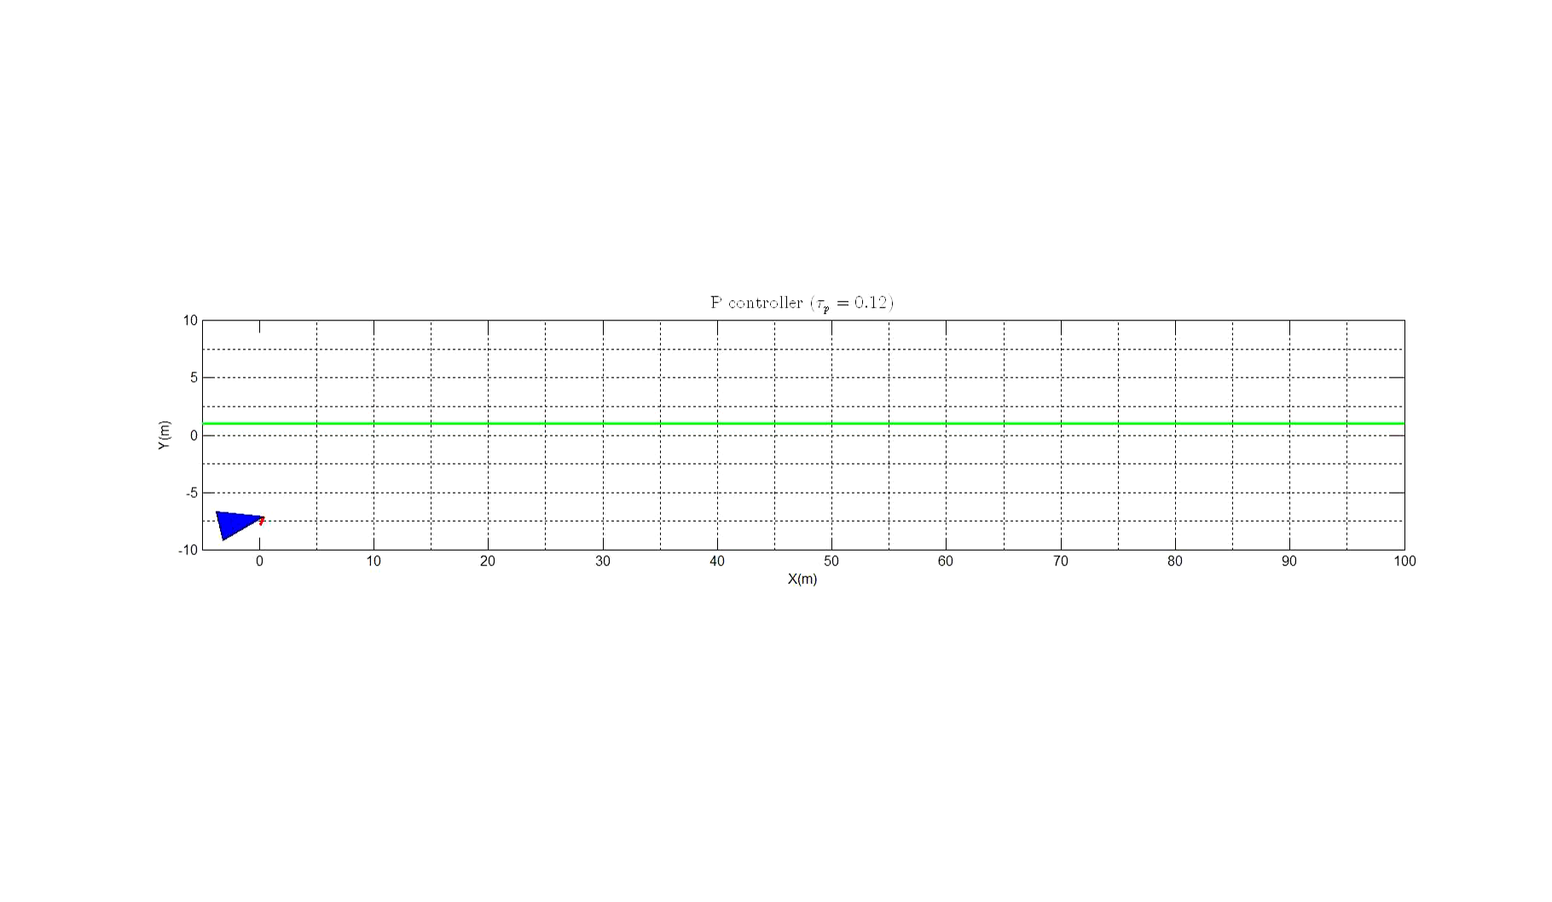

Slide 11
The car oscillates about the reference trajectory

Slide 12
P (Proportional)
D (Derivative)
Controller

Slide 13
P72
steerDrift = degtorad(30);
for i = 1 : n
%% ================= PD controller ===============
err = pos(2) - target;
diffErr = err - preErr;
preErr = err;
steer = -tauP * err - tauD * diffErr / dt;
pos = moveRob(pos, constVel, steer + steerDrift, dt, wheelbase);
%% ==============================================
end

Slide 14


Slide 15
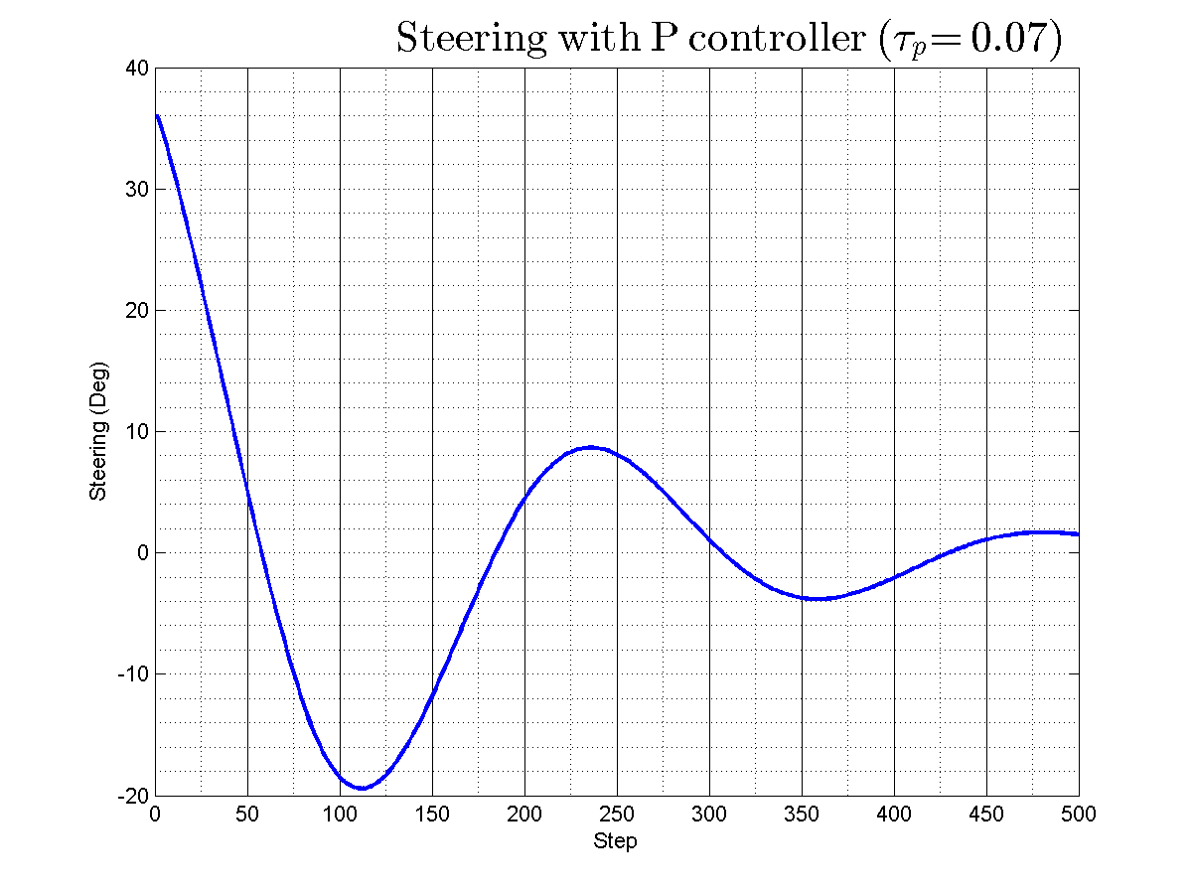
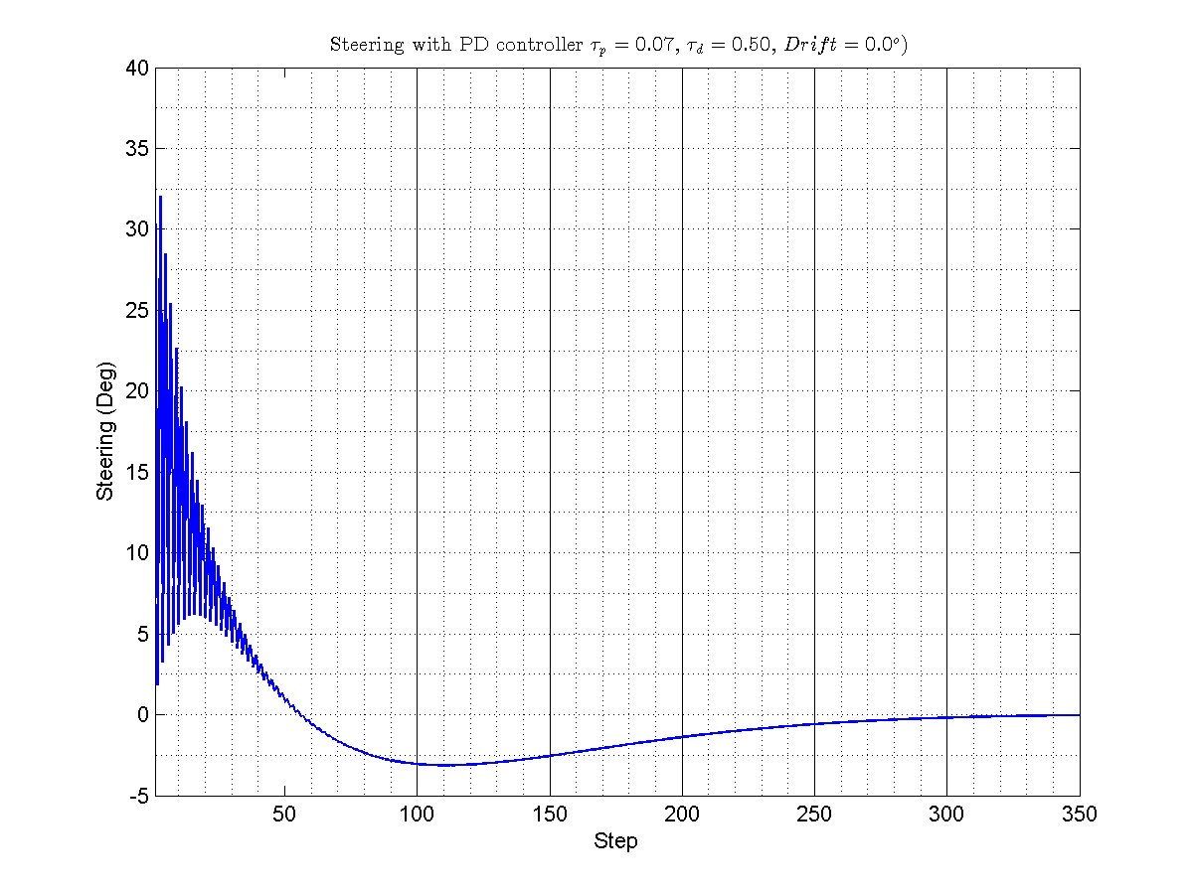

Slide 16
Systematic bias
a common problem in robotics. An example of systematic bias is when you order your car and you believe that the front wheels are 100% aligned but they are actually aligned a little bit at an angle. For human drivers that isn't a big concern. When a driver notices this they just steer a little bit stronger.

Slide 17
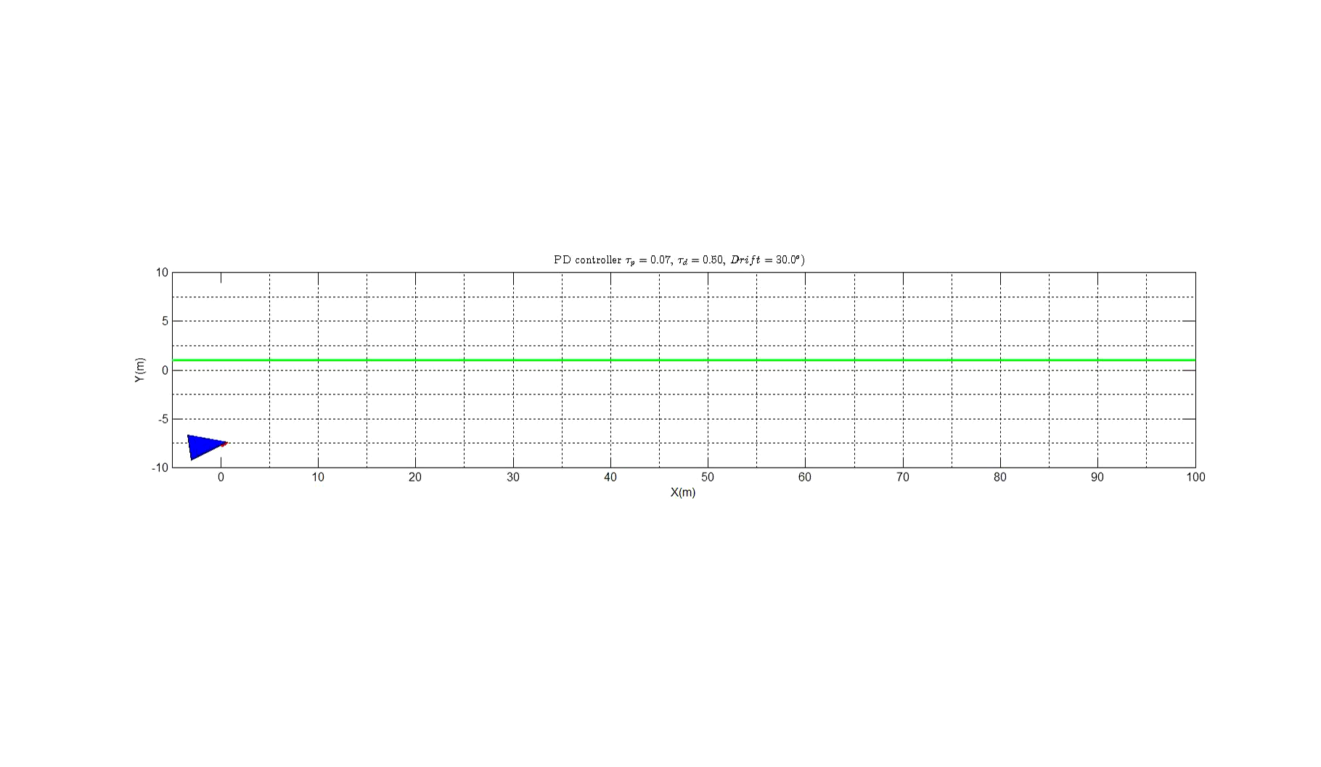

Slide 18
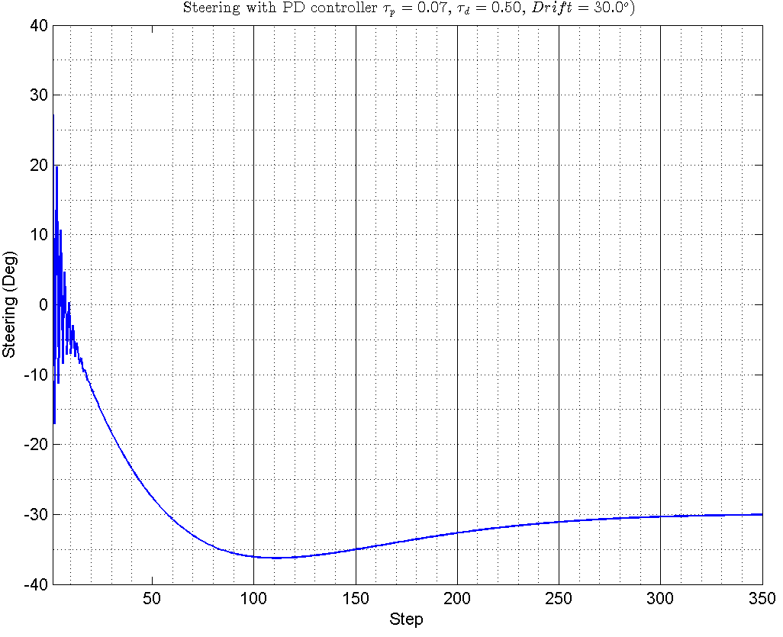

Slide 19
P (Proportional)
I (Integral)
D (Derivative)
Controller

Slide 20
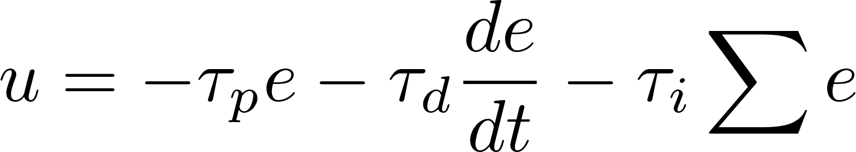
P73
steerDrift = degtorad(30);
for i = 1 : n
%% ================= PD controller ===============
err = pos(2) - target;
diffErr = err - preErr;
preErr = err;
steer = -tauP * err - tauD * diffErr / dt;
pos = moveRob(pos, constVel, steer + steerDrift, dt, wheelbase);
%% ==============================================
end

Slide 21
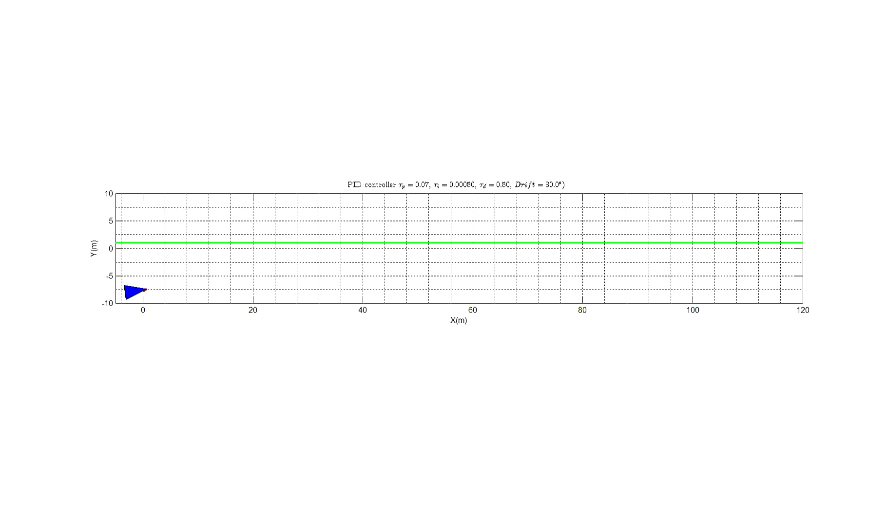

Slide 22
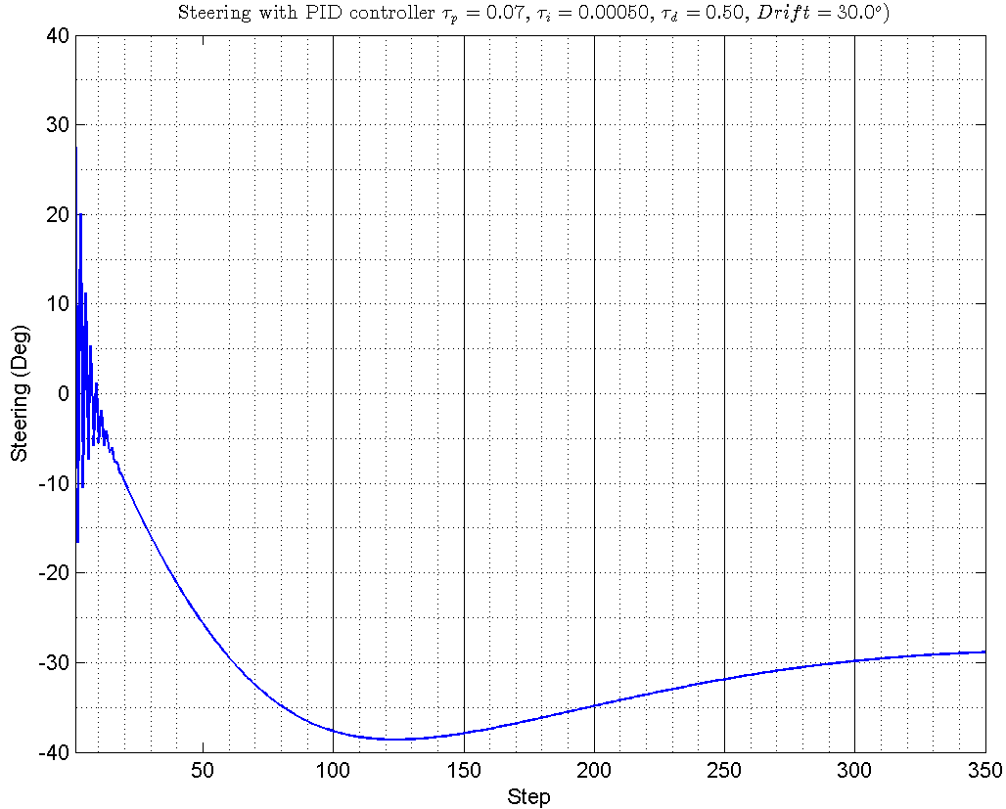

Slide 23
Determine the PID gains

